Slide 1
London
Plesu Catalin
himself

Slide 2
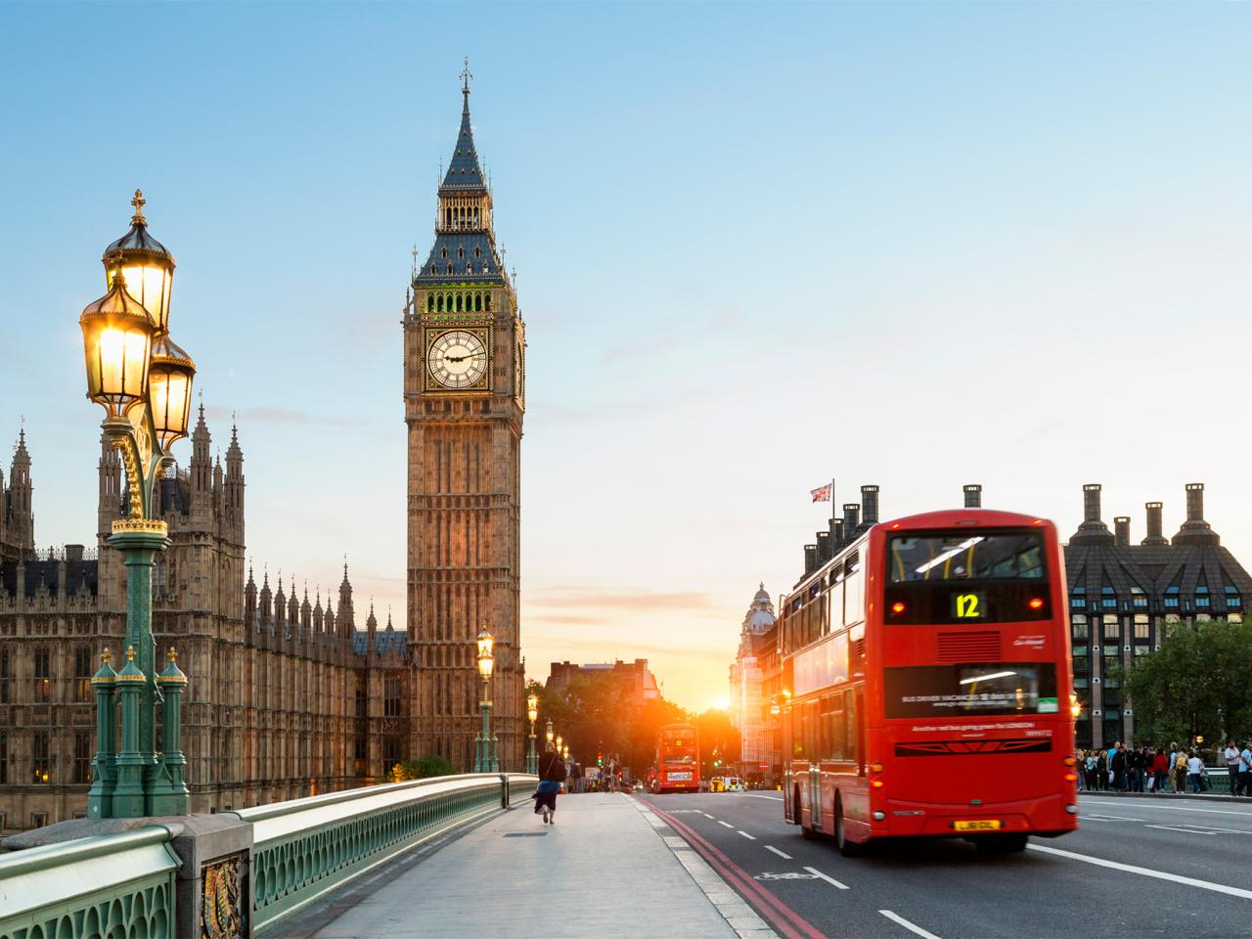
London is the capital city of England and is located in the south east of the country

Slide 3
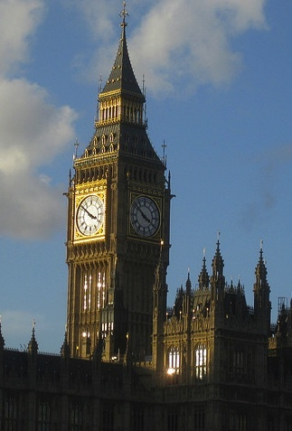
Big Ben: The Tower With Five Names
Big Ben
St Stephen's Tower
The Clock Tower
The Elizabeth Tower
The east tower

Slide 4
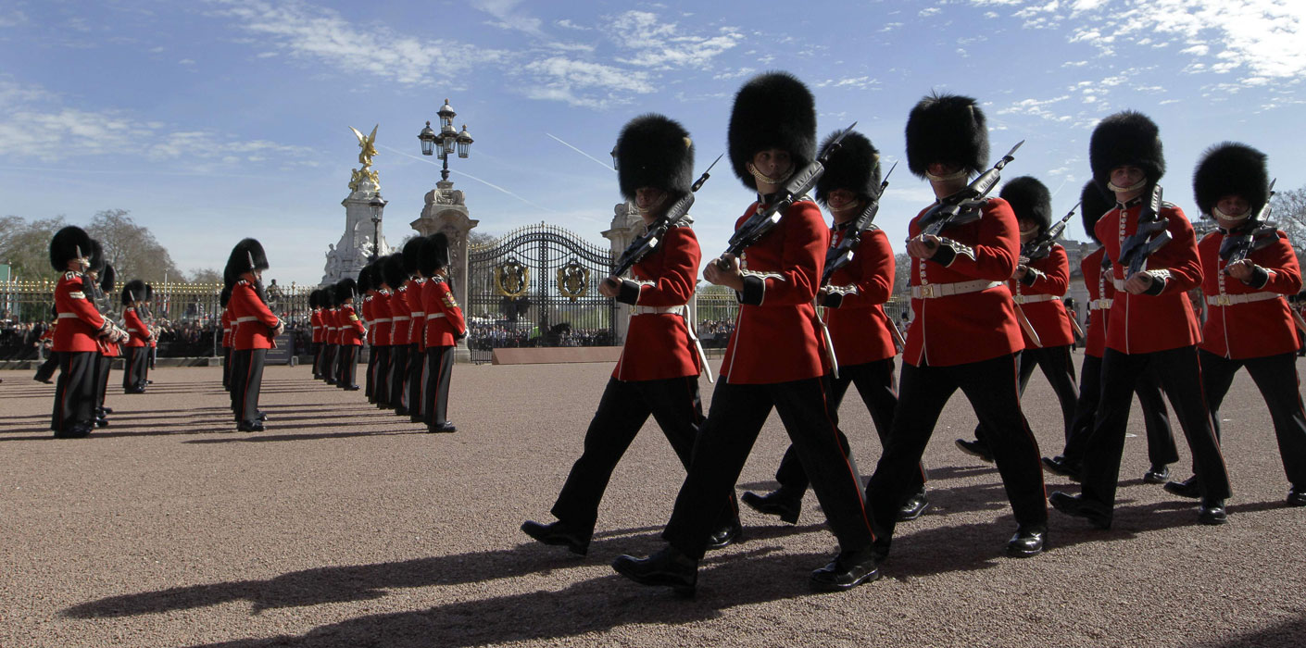
Queen's Guard

Slide 5
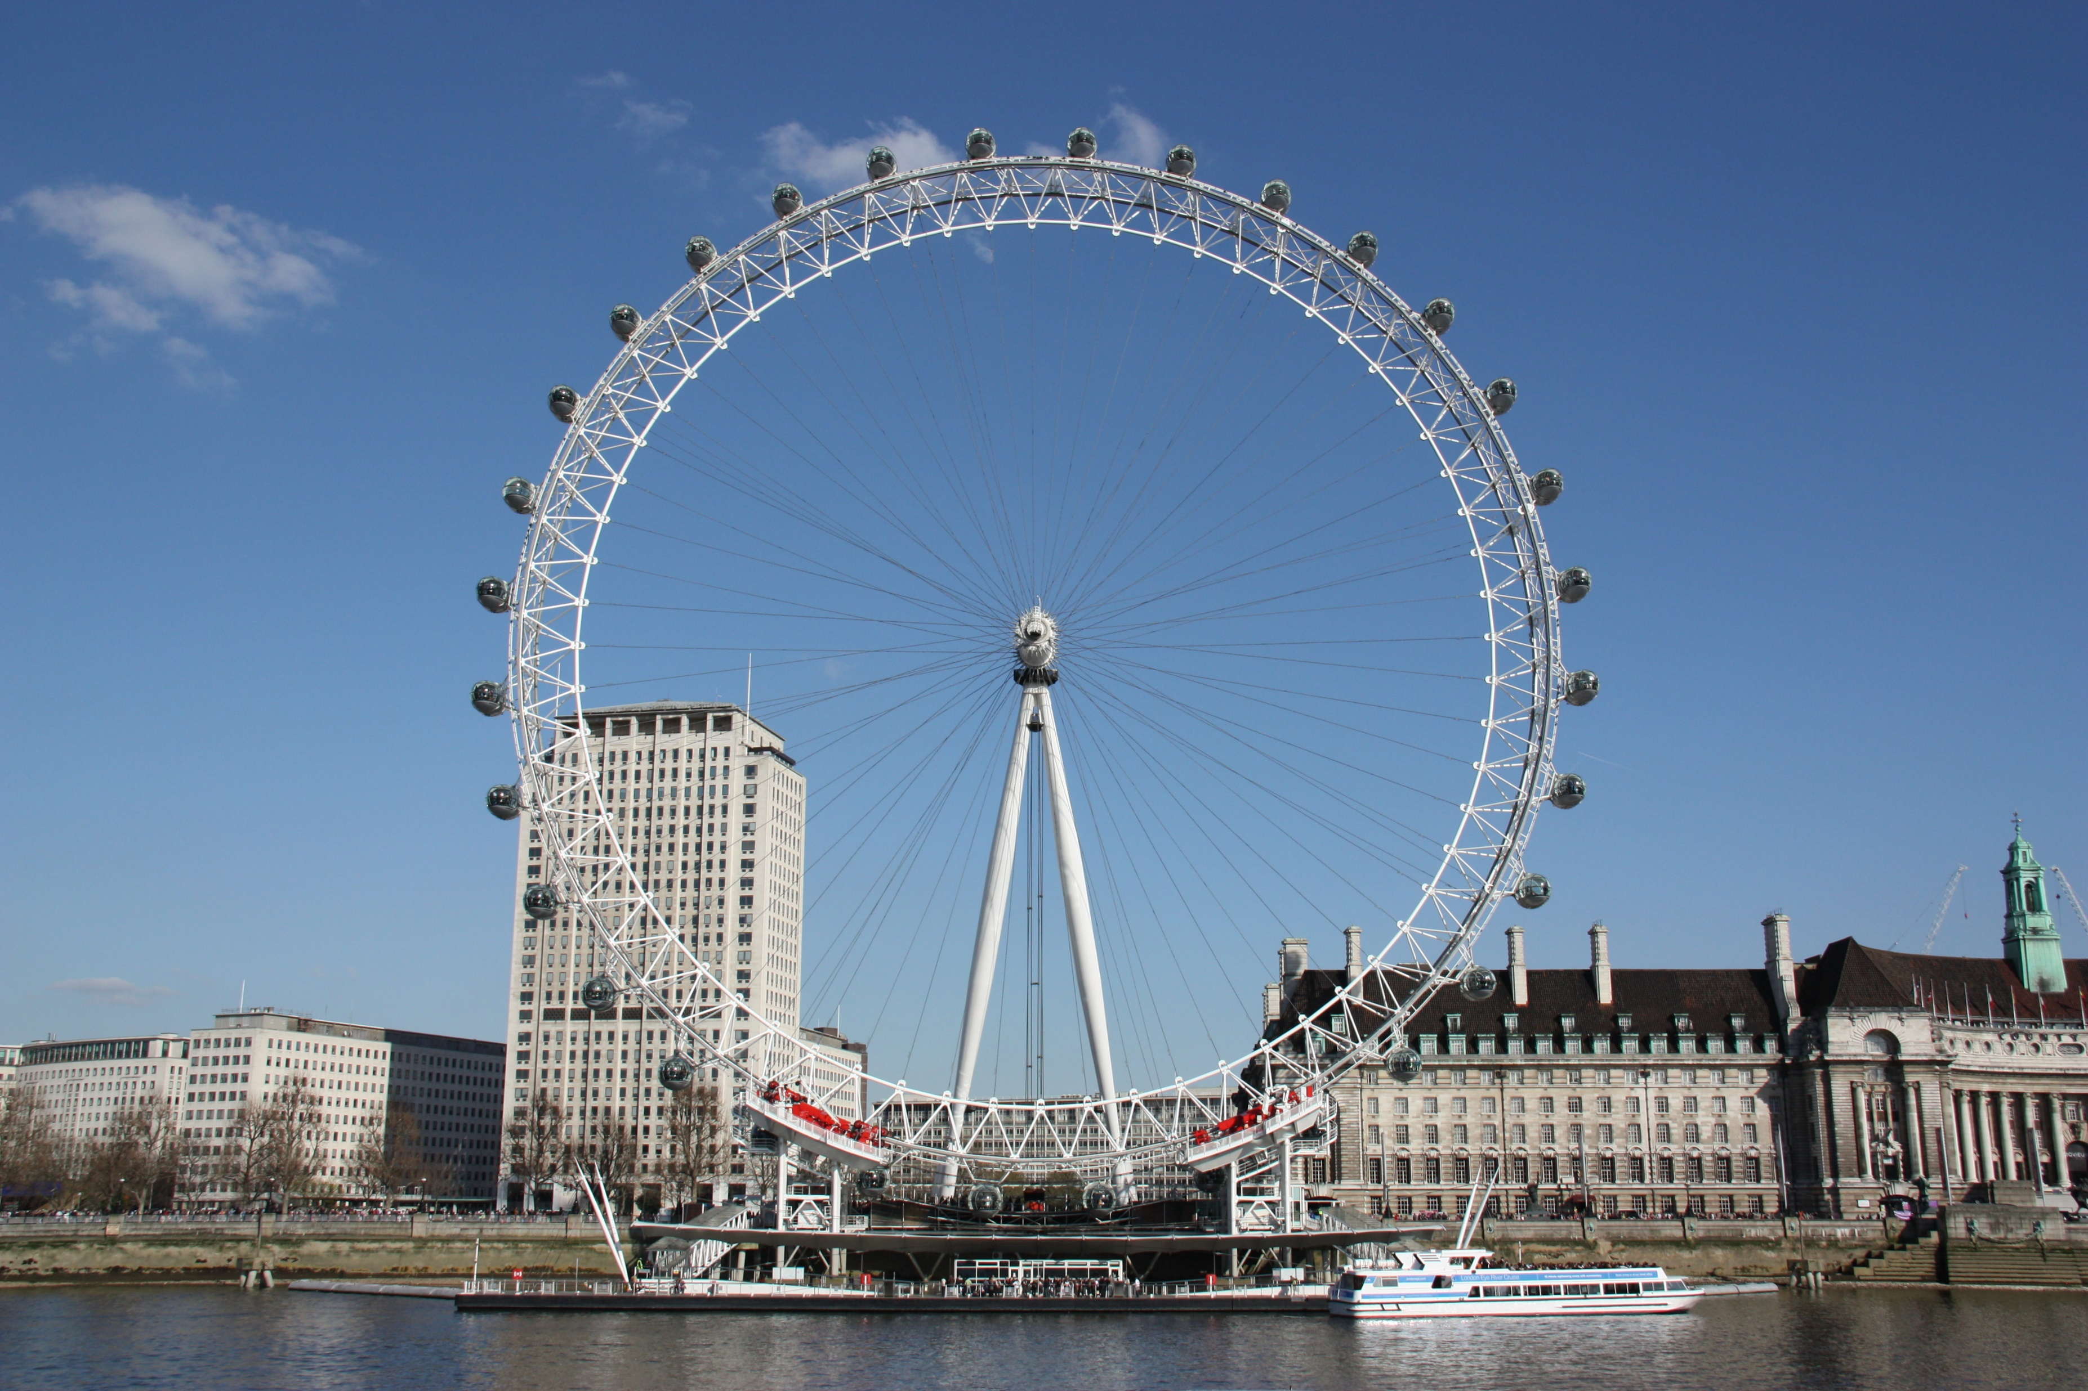
London Eye

Slide 6
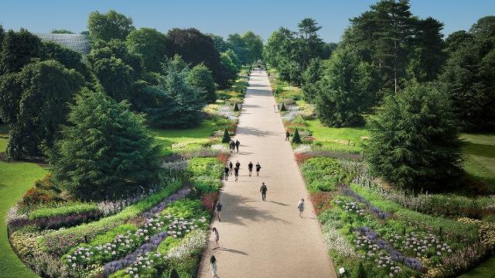
Royal Botanic Gardens, Kew

Slide 7
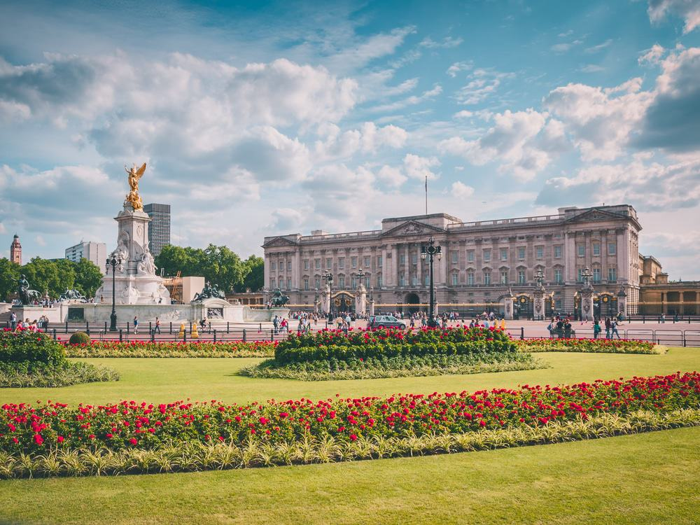
Buckingham Palace

Slide 8
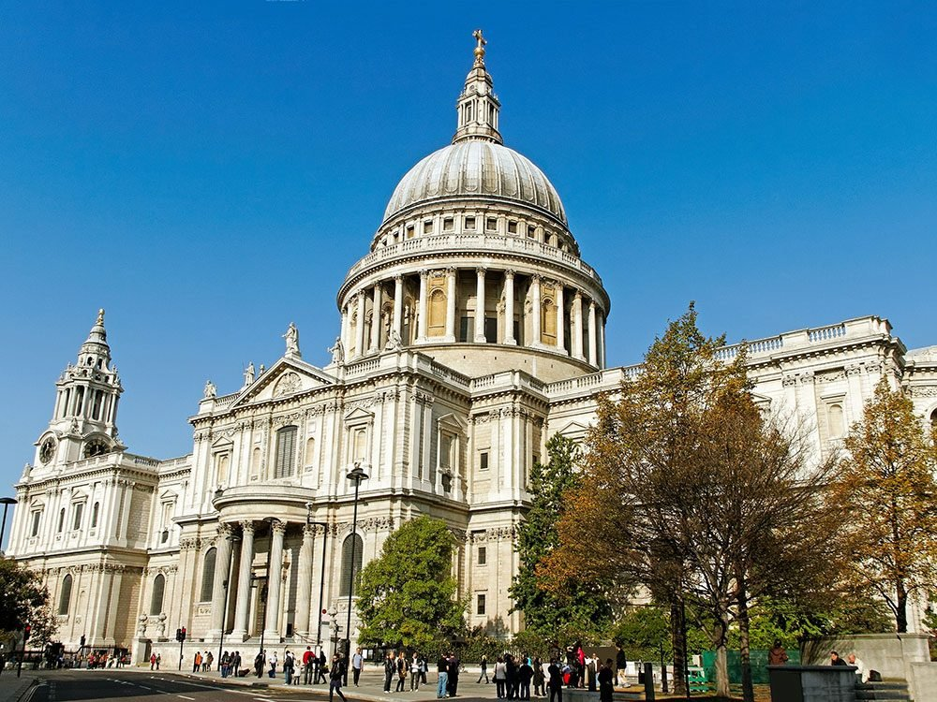
St. Paul’s Cathedral

